Slide 1
CHINA OUTBOUND:
ARE WE NEARLY THERE YET?
Wednesday January 24th, 2024
www.oag.com

Slide 2
SPEAKERS
CHIEF ANALYST
GUEST SPEAKER
MODERATOR
John Grant
Chief Analyst, OAG
Simon Westaway
Strategy Director, RoyceComm
Deirdre Fulton
Partner, MIDAS Aviation
With a wealth of experience across the global aviation industry, John provides expert commentary on market developments for OAG, making connections between what the data is telling us and the trends and events occurring in the sector.
Simon is an experienced, Australian-based business strategy and corporate affairs leader and advises many tourism, transport and visitor economy businesses as a Director through the boutique consultancy, Royce, based in Melbourne.
A previous senior executive for the former Australian regional and domestic airline, Impulse Airlines, over 25-years of aviation and tourism experience also saw him as Executive Director of the Australian Tourism Industry Council. Simon was a foundation senior executive of the Qantas Group’s successful low cost carrier, Jetstar, from 2004 and through its formative years of Australasian and South East Asian growth. He as also a former ExCo executive at Australian regional carrier Impulse.
Simon continues to work closely with Australian and South-East Asian aviation and tourism businesses.
Deirdre is a partner in an aviation consultancy providing meaningful insight and analysis to clients around the world. She works closely with OAG on their data analysis and publications.

Slide 3
UNLOCKING GLOBAL TRAVEL: IS CHINA THE KEY?
In this webinar we’ll be looking at:
Freedom to travel: changes to visas may yet stimulate growth
Latest position for China's biggest airlines: networks, orders and capacity
Where is everyone going?
Will we really see Chinese outbound travel return this year?
We’ll take Questions and Answers through the webinar

Slide 4
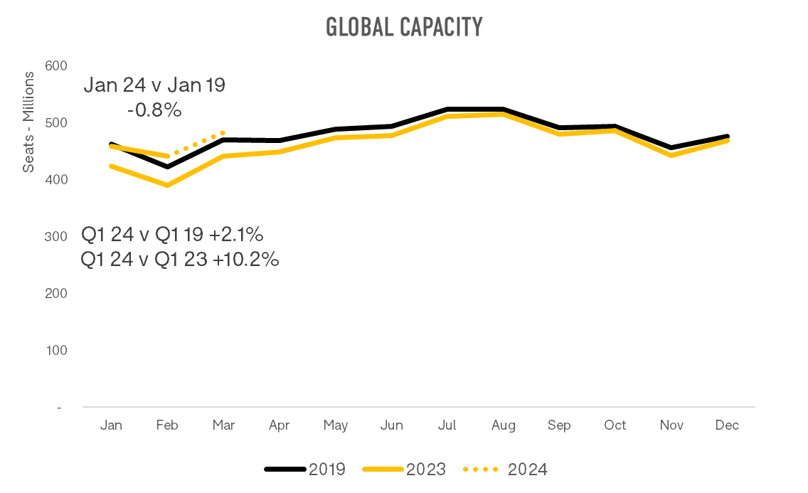
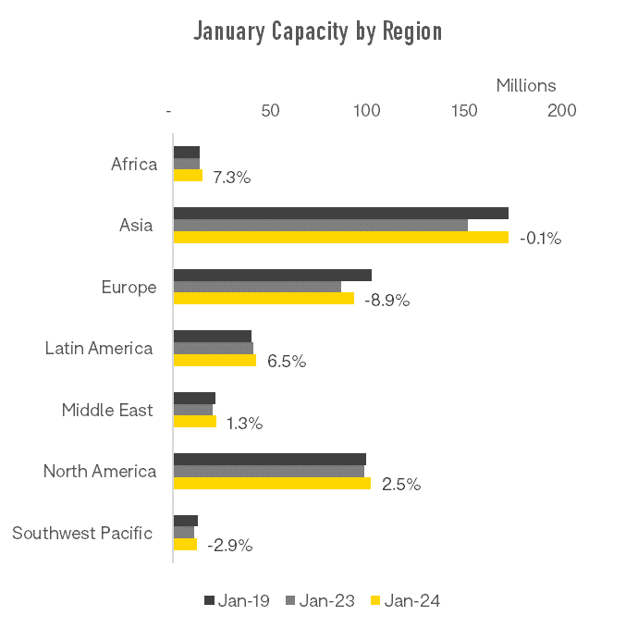
GLOBALLY CAPACITY BACK WHERE IT WAS IN 2019
Globally, capacity is slightly below 2019 this month, but over Q1, is expected to see an increase of 10.2% on last year and 2.1% up on 2019

Slide 5
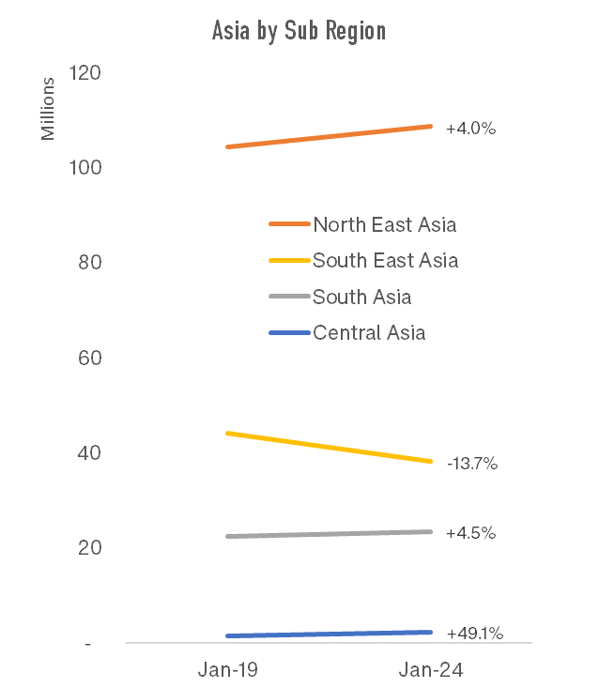
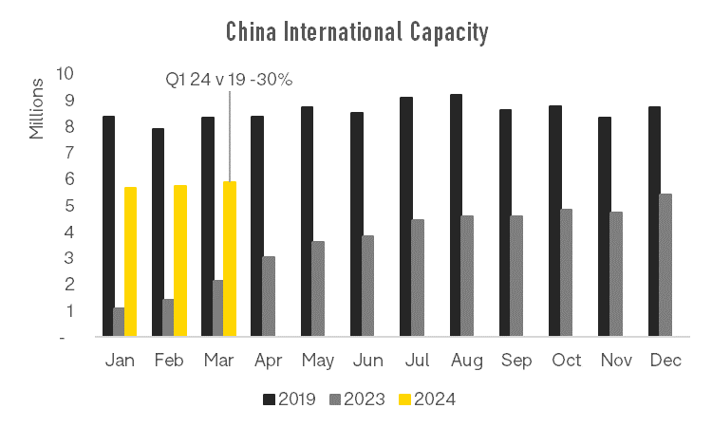
CHINA CAPACITY: HAS THE SURGE BEGUN?
Across Asia all regions have reached and exceeded 2019 capacity except for South-East Asia
This is largely due to North-East Asian and European markets travelling to/from South-East Asia having not yet fully recovered
China international capacity expected to be 30% below 2019 in Q1
Notes:
China previously accounted for 40% of the South East Asia market, and is currently 30%

Slide 6
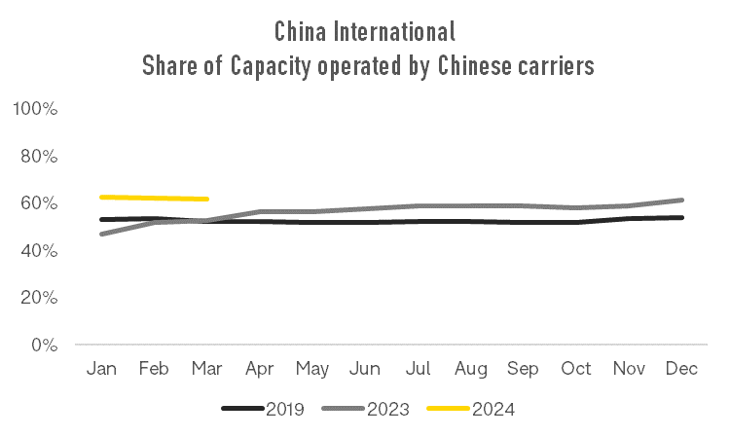
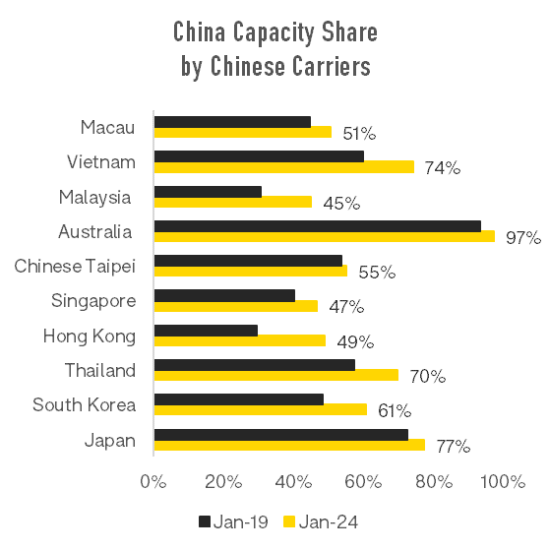
CHINA CAPACITY: WHO IS LEADING THE RETURN?
The share of international capacity to/from China operated by Chinese carriers is increasing – now 63%, up from 47% in Jan 2023 and 53% in Jan 2019
For China’s Top 10 outbound markets every country has seen an increase in the share of capacity operated by Chinese domiciled carriers
Notes:
China previously accounted for 40% of the South East Asia market, and is currently 30%

Slide 7
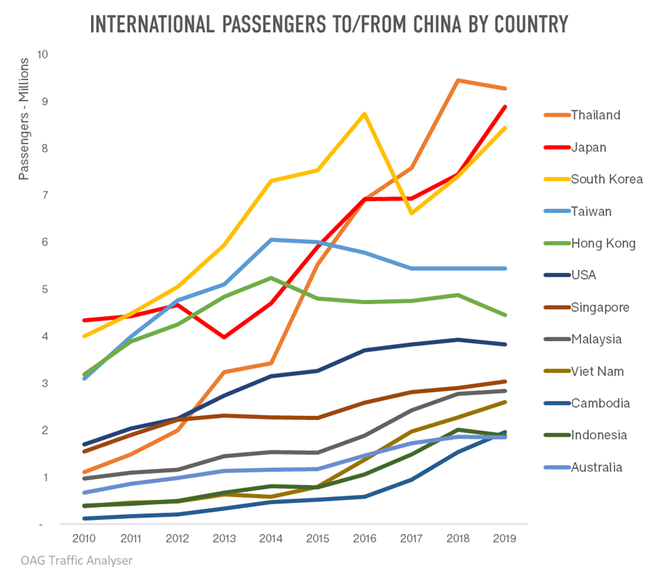
CHINA – LARGEST OUTBOUND TRAVEL MARKET Largest and most valuable outbound travel market
147m air passengers to/from China in 2019, up from 56m in 2010
Chinese outbound tourism had highest expenditure of any nationality at USD254 bn in 2019 (vs USD152bn for US)
Average growth of international passengers by air 11.2% since 2010
Thailand 27% Viet Nam 37% Indonesia 19%
Between 2010 and 2019, 60m more passengers between China and North-East Asia, 19m more to/from South-East Asia, 4m to/from Europe and 3m to North America and SW Pacific
Fewer than 10% of Chinese have a passport but 10m new passports were being issued annually
Notes:
If you fly with Saudi half of boarding card is your visa

Slide 8
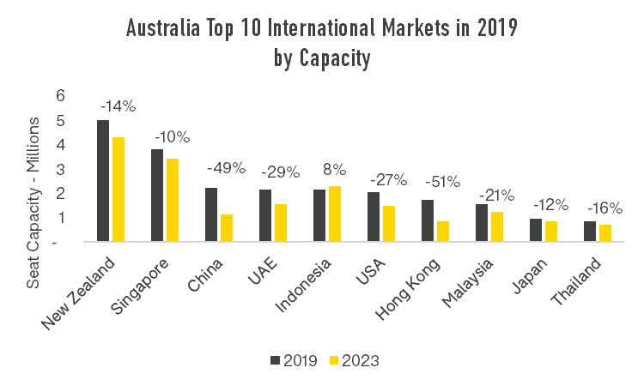
AUSTRALIA: LARGEST MARKETS NOT FULLY BACK TO 2019 LEVELS
Australia International Markets
2019 | 2023
New Zealand | New Zealand
Singapore | Singapore
China | Indonesia
UAE | UAE
Indonesia | USA
USA | Malaysia
Hong Kong | China
Malaysia | Qatar
Japan | Hong Kong
Thailand | Japan
If we look at the Top 10 international markets in 2019 ranked by capacity, of these, only Indonesia has seen seats recover back to 2019 levels, driven by strong outbound leisure market
The Top 10 in 2013 looks different – Thailand has dropped out, pushed down by Qatar which has emerged as an important connecting point to Europe and China has dropped down from 3rd to 7th
Notes:
China previously accounted for 40% of the South East Asia market, and is currently 30%

Slide 9
FROM CLOSED DOORS TO OPEN BORDERS 2024 sees visa regime changing rapidly
Visa waivers and changes underway
In late 2023, China announced visa free travel for 5 European countries and Malaysia for a year.
Steps have also been taken to simplify tourist visas for USA residents wishing to travel to China.
China and Singapore have begun discussions to implement a visa free policy, likely to take effect in early 2024
China reciprocal visa issues means that China has never been more accessible.
Does this mean a significant shift in mindset from the Chinese perspective?
Country | Simplification of Visas underway | Visa Free discussions underway | Visa Free Trial | Visa Free
Thailand |  |  |  | X
Malaysia |  |  | X
France |  |  | X
Germany |  |  | X
Italy |  |  | X
Netherlands |  |  | X
Spain |  |  | X
Singapore |  | X
USA | X
Ireland |  |  |  | X
Switzerland |  |  |  | X
Notes:
If you fly with Saudi half of boarding card is your visa

Slide 10
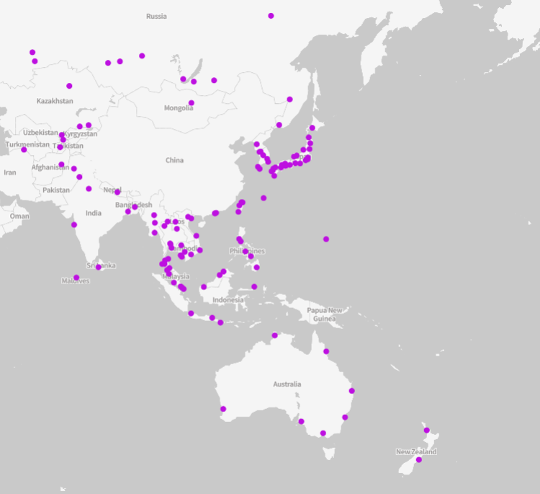
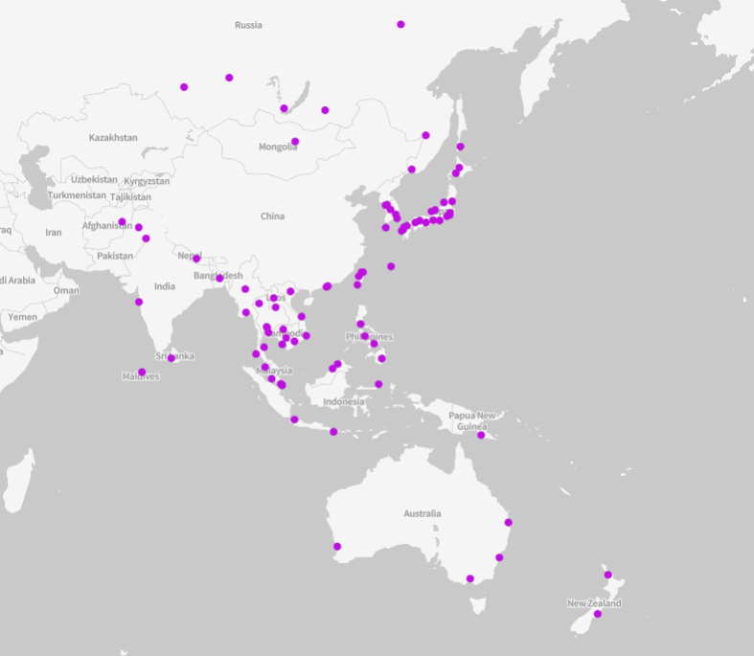
INTERNATIONAL DESTINATIONS THEN AND NOW From China to Asia Pacific
Jan 2019
Jan 2024
Australia: 7
Australia: 4
Asia Pacific - 119 international destinations
Asia Pacific - 85 international destinations
Notes:
Missing routes:
SE Asia: CRK, SUB, HDY, KLO, KCH, LGK, TNJ, REP,KOS, KBV, NYT, URT, CEI, HPH
Australia: DRW, CNS, ADL
Also SPN

Slide 11
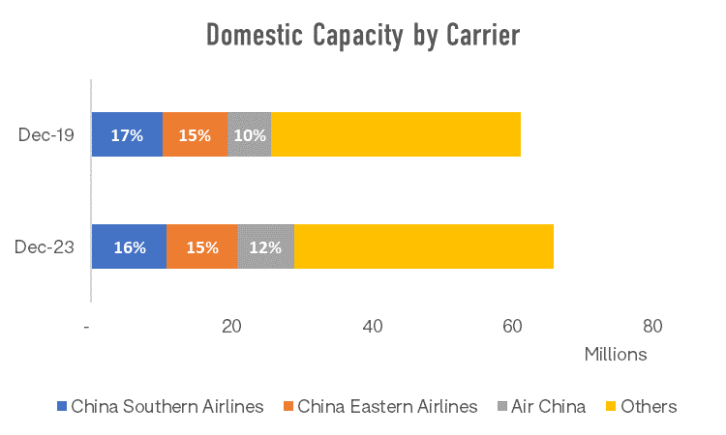
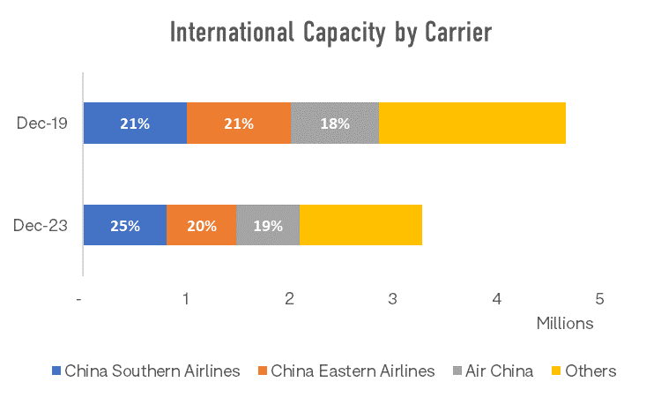
LATEST POSITION FOR CHINA'S BIGGEST AIRLINES Networks, orders and capacity
FLEET & AIRCRAFT ORDERS
 | In service | Inactive | On order
Air China | 473 | 27 | 107
China Southern | 594 | 22 | 165
China Eastern | 563 | 10 | 101
B787 Max 8’s
 | Fleet | Order | Due this year
Air China | 16 | 23 | 11
China Southern |  | 12 | 5
China Eastern | 24 | 49 | 16
China suspended Boeing Jet deliveries after the 737Max issues in 2019
Latest blowout issue has renewed concerns and additional safety inspections likely although no Chinese airlines currently operate a 737Max 9
According to Boeing, China will account for 20% of global airplane demand until 2042

Slide 12
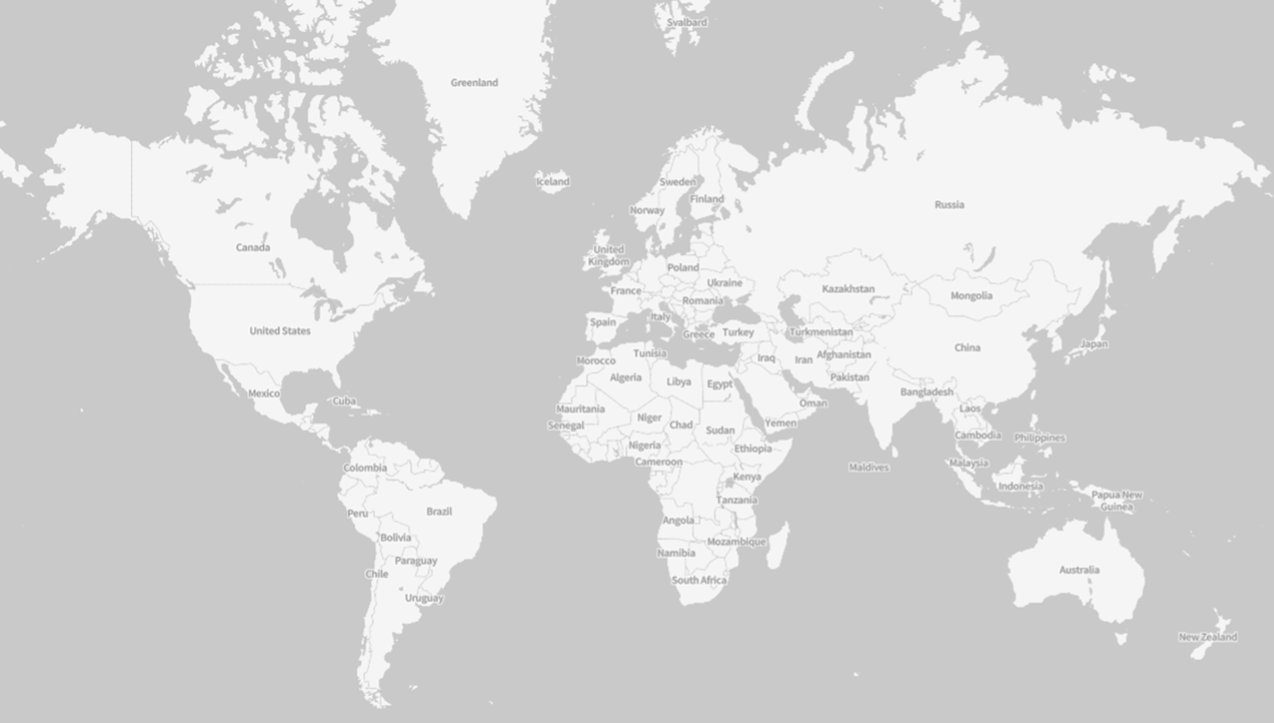
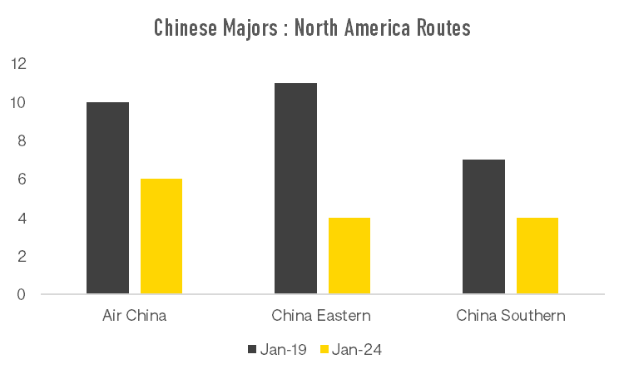
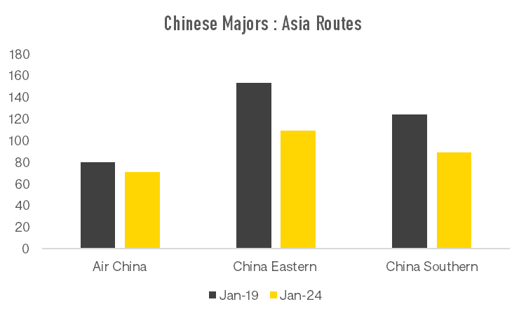
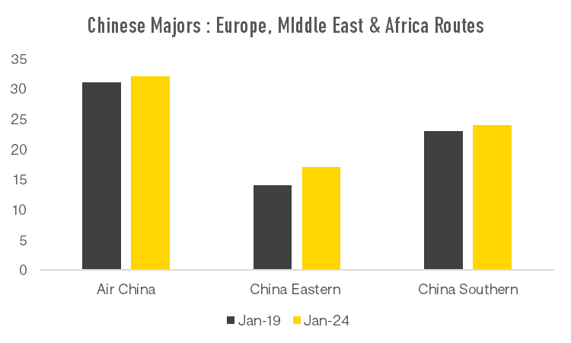
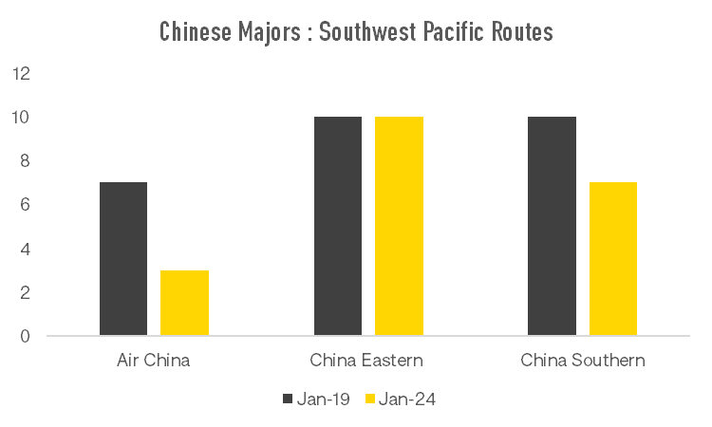
LATEST POSITION FOR CHINA'S BIGGEST AIRLINES Networks, orders and capacity

Slide 13
ASIA’S CHINA TOURISM TARGETS: STEADY GROWTH EXPECTED
Thailand’s tourism authority recorded 3.5m Chinese tourists in 2023, with 8.2m targeted for 2024, In 2019, the figure was 11m.
Australia had 1.4m Chinese tourists in 2019, and statistics for Jan-Sep 23 report just under 0.5m.
Cambodia expected to reach 700,000 Chinese tourists in 2023, after targeting 1m.
Indonesia recorded 570,000 Chinese tourists from Jan-Sep 2023, a long way off 2.07m in 2019, Projections are for 2024 to return to 2019 levels.
How do South East Asian tourist destinations differentiate themselves?
Saudi Arabia has a target of 5m Chinese tourists by 2030, from 100,000 in 2023.
For context Shanghai – Riyadh is 12h30 v Shanghai – Sydney 10h30

Slide 14
OTHER INDUSTRY DEVELOPMENTS
Resource constraints continue – airlines globally were working out in the second half of 2023 how to manage the Pratt and Whitney engine issues, maintenance delays were being impacted by spare part delays and the availability of resources
Since then, an issue with a Boeing 737 Max 9 Alaska Airlines aircraft has seen this variant grounded

Slide 15
STAY INFORMED
SIGN UP TO OUR BLOG www.oag.com/blog
REGULAR UPDATES ON OUR TRAVEL RECOVERY PAGE www.oag.com/coronavirus-airline-schedules-data
e: contactus@oag.com | www.oag.com
www.oag.com

